Slide 1
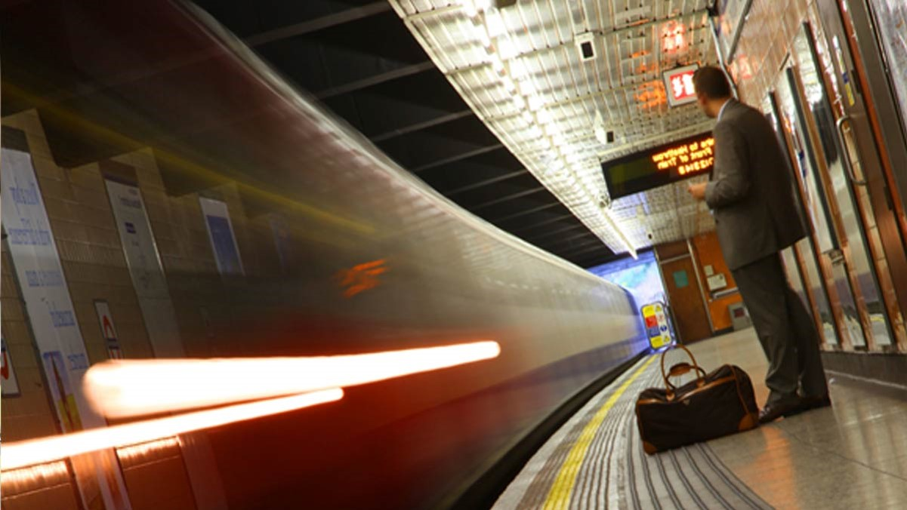
Reusable Coffee Cup:
through ease-of-use to market penetration
Team – 4 Layers
Alexandra Haas
Christian Kirifidis
Michael Schröder
Sergej Bannik

Slide 2
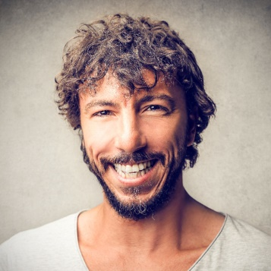

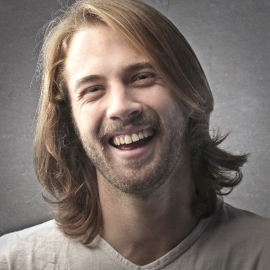
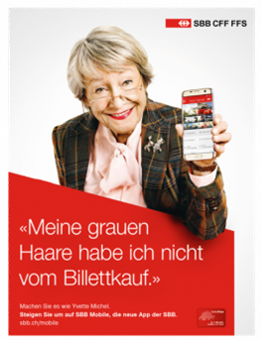
COMMUTER
30-50, WORKING
ca. 20-60min train rides – ideal for drinking coffee
Earning well, buying coffee to go is a daily routine
Voting and caring for sustainability to insure future for kids
STUDENT
18-29, STUDENT
enjoying cosmopolitan city life and wanting to feel hip
The “Starbucks-Generation” and Digital Native, but caring for earth
Own income or getting money from parents
well equipped with apps like TWINT, SBB/Swisspass
TOURIST / TRAVELLER
30-50, INDIVIDUAL
Able to afford Swiss Coffee prices
In a leisure time
Travelling by train, individually (no group)
Not necessarily equipped with Swiss apps.
ACTIVE PENSIONER
>60, OLDIE GOLDIE
Well off, digitally educated by grandchildren
Feeling young, caring for earth, open to new things
Not neccessarrily TWINT / Swisspass App
#WHO

Slide 3
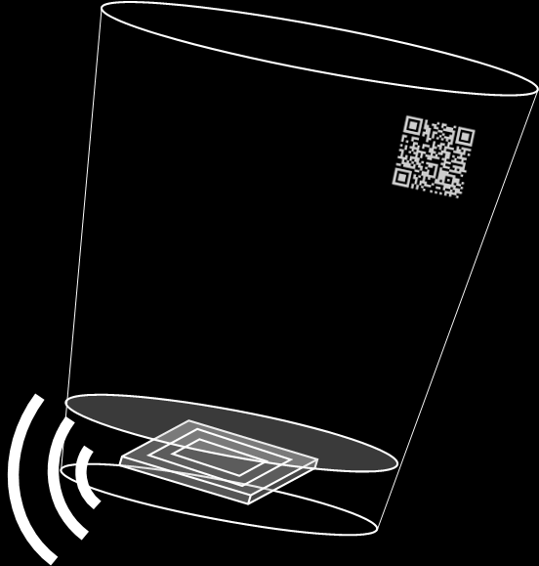
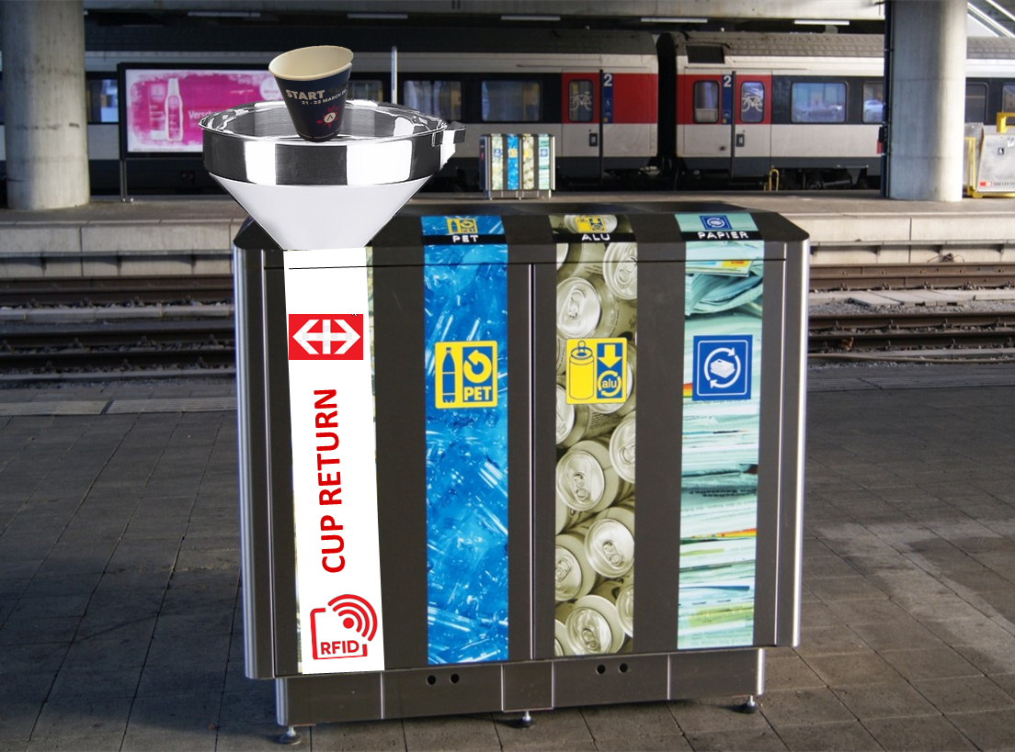
scan QR-code to define refund method
#RFID
#EASily BUILt
#NO QUEUE
#FUN
RFID chip to check cup-return & map to QR code
#HOW

Slide 4
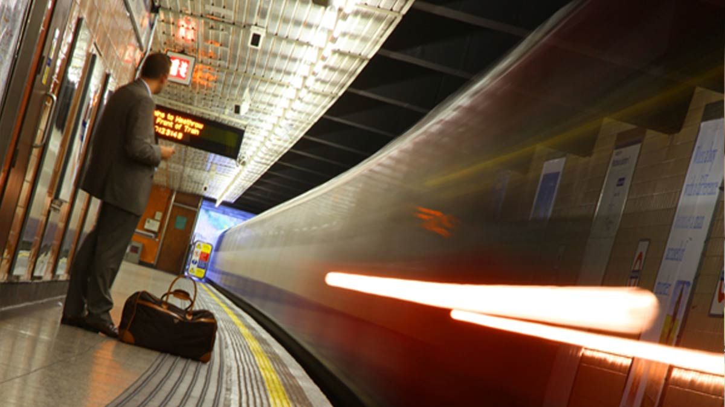

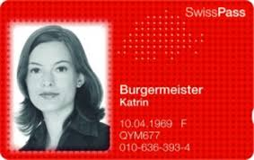
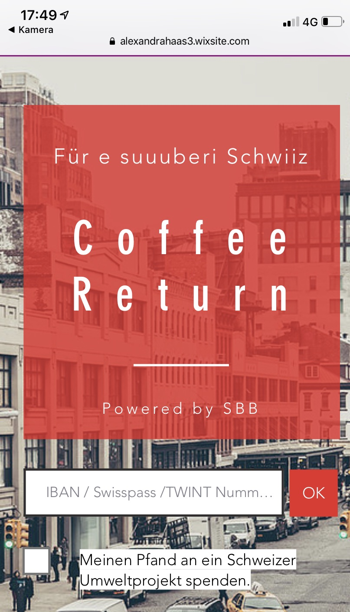

BUY
DRINK
RETURN
REFLECT
SCAN & PLAN
SHARE
REFUND
SHOP
PAY
DRINK
DROP
DONATE
FIND SHOP
EMOTIONS
neutral
Business as usual
Stress risk
Fun and games
#JOURNEY

Slide 5
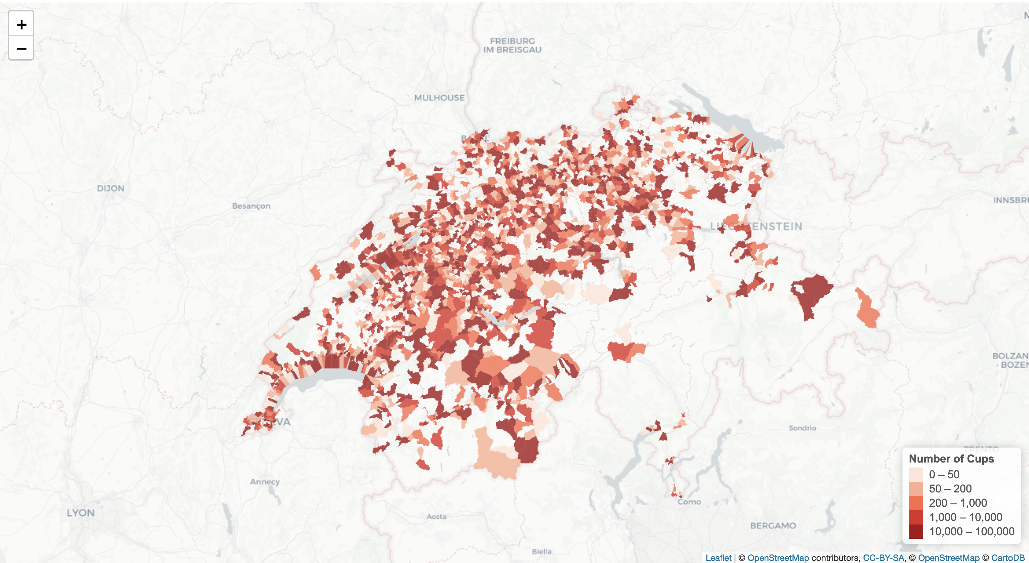
230 Train Stations in Switzerland
Modelling trips with mobile cell data from Swisscom Open Source
EXTRAPOLATE needed #return-maschines per TRIP END POINT
MAP SHOPS FOR MANUAL RETURN
©Swisscom open data - mobile cell data public transport
#WHERE

Slide 6




230 Train Stations in Switzerland
Modelling trips with mobile cell data from Swisscom Open Source
EXTRAPOLATE needed #return-maschines per TRIP END POINT
MAP SHOPS FOR MANUAL RETURN
©Swisscom open data - mobile cell data public transport
#WHERE

Slide 7
230 Train Stations in Switzerland
Modelling trips with mobile cell data from Swisscom Open Source
#DROP BINS = 723
EXTRAPOLATE needed #return-maschines per TRIP END POINT
MAP SHOPS FOR MANUAL RETURN
©Swisscom open data - mobile cell data public transport
#WHERE

Slide 8
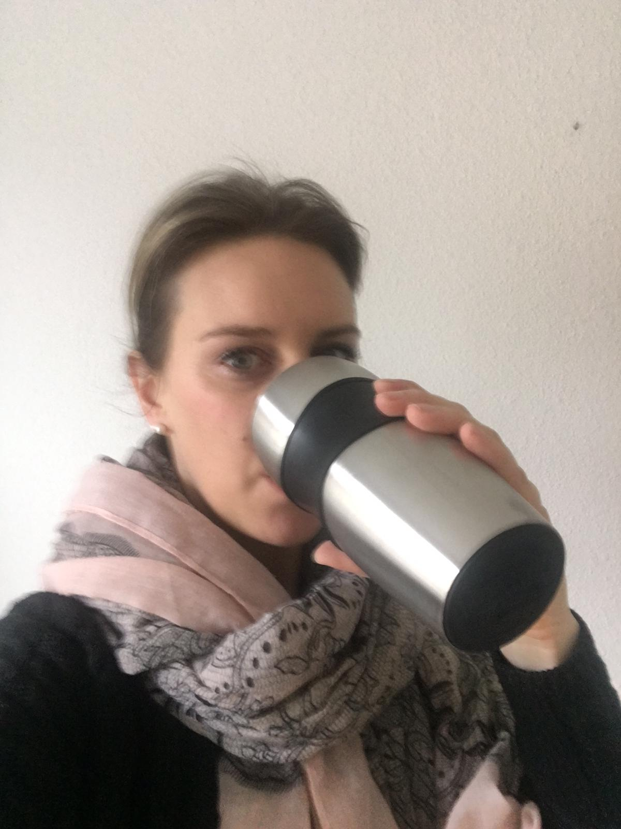
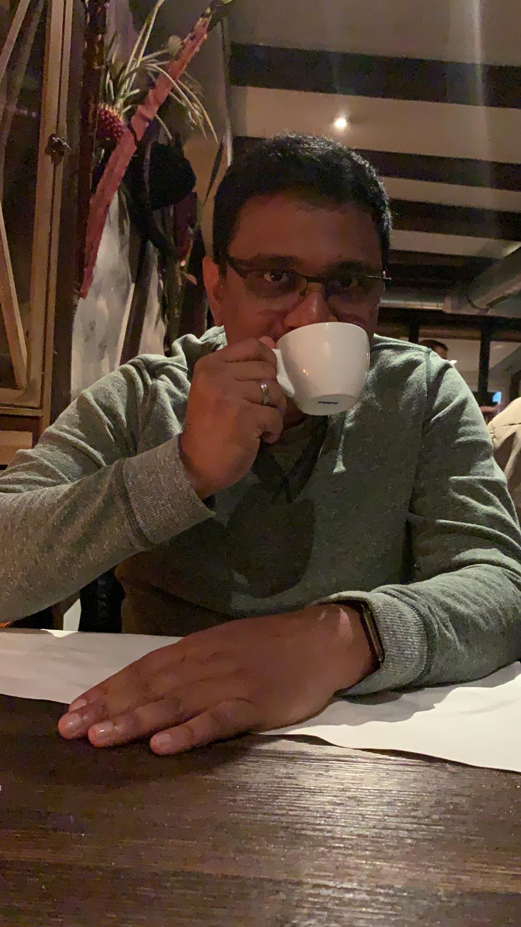
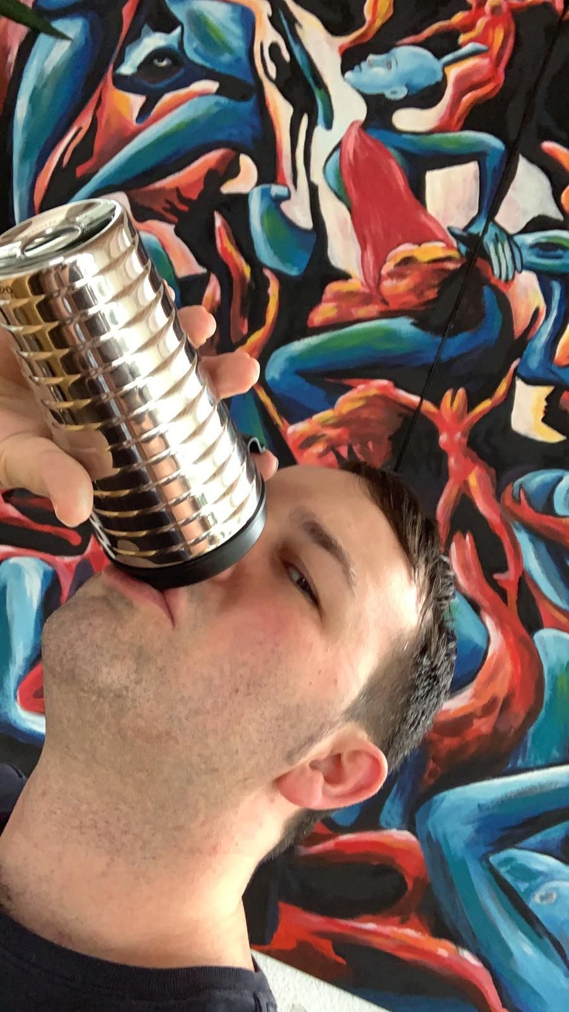
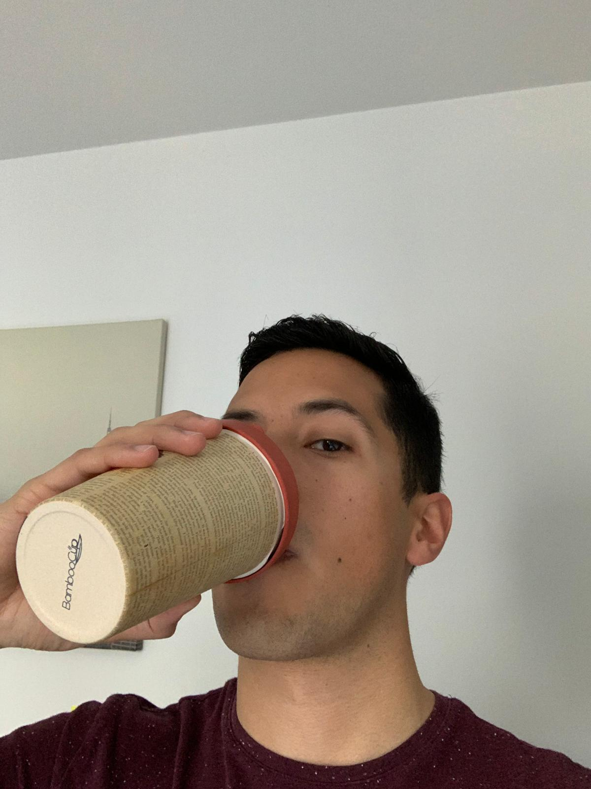

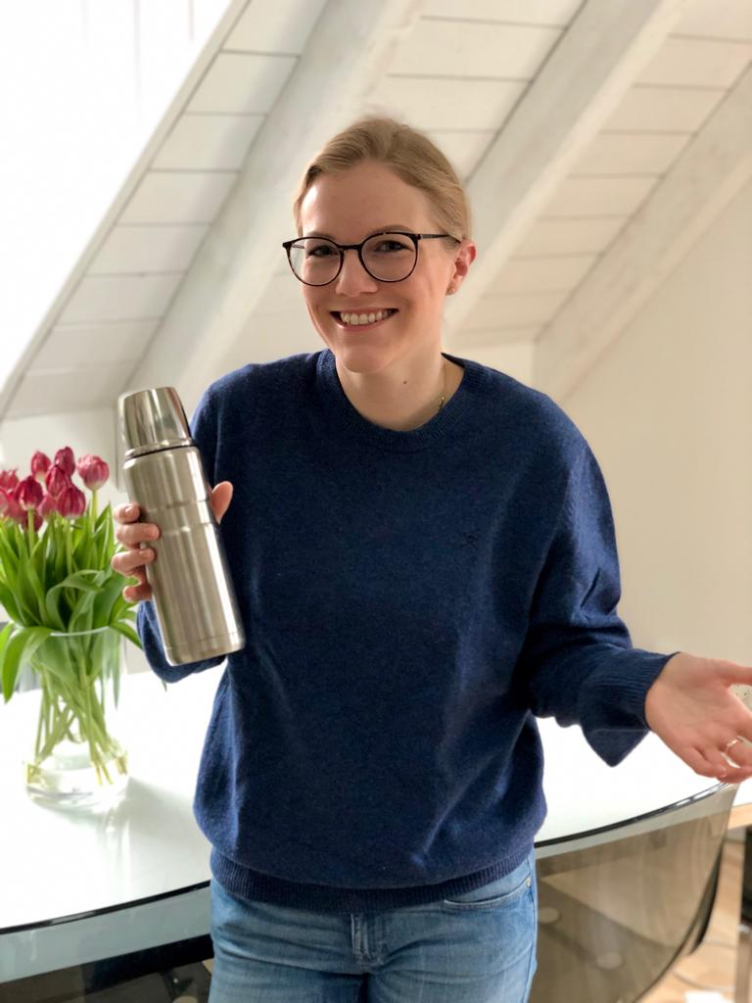
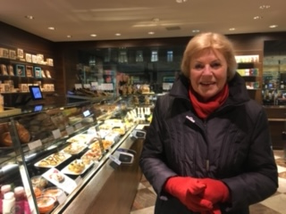
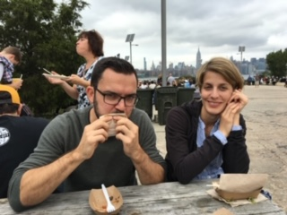
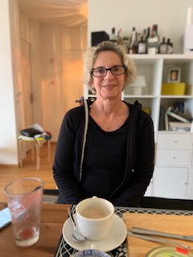
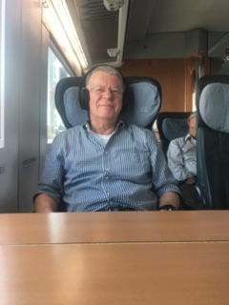
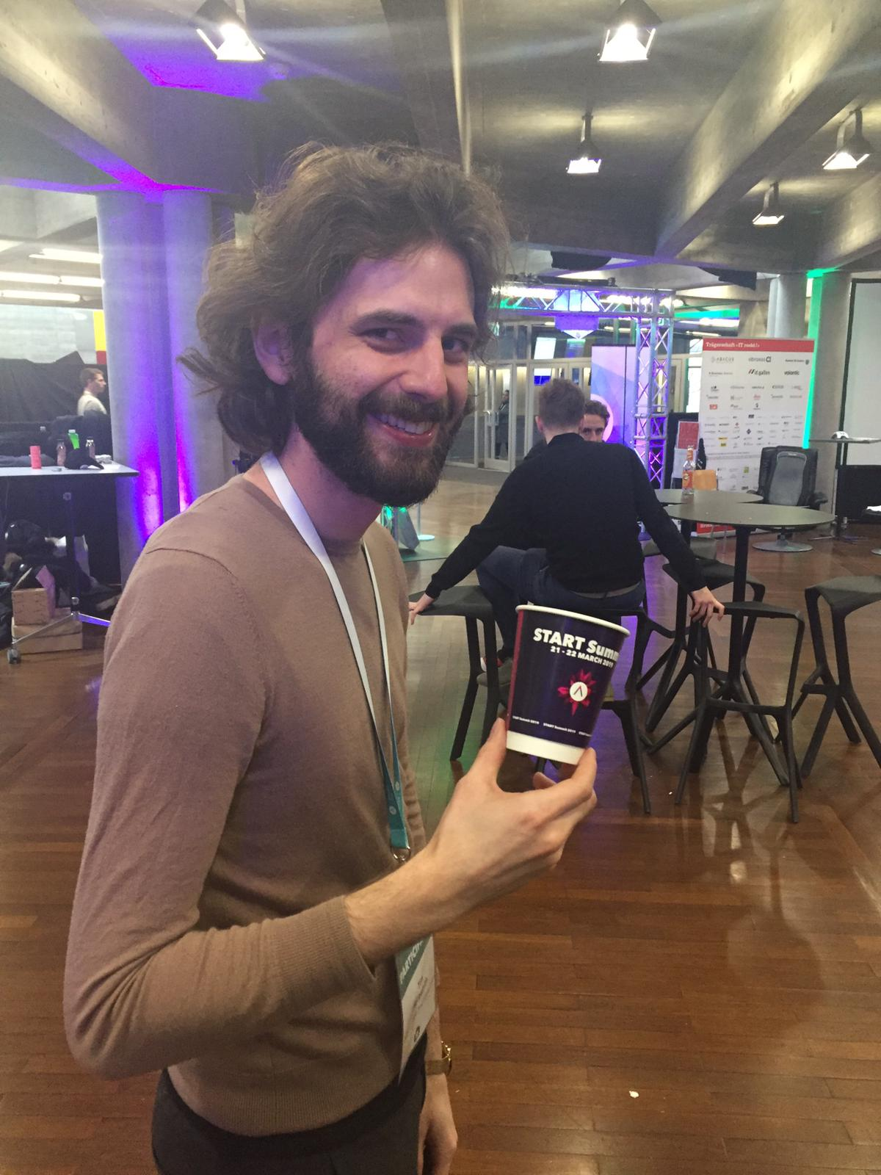
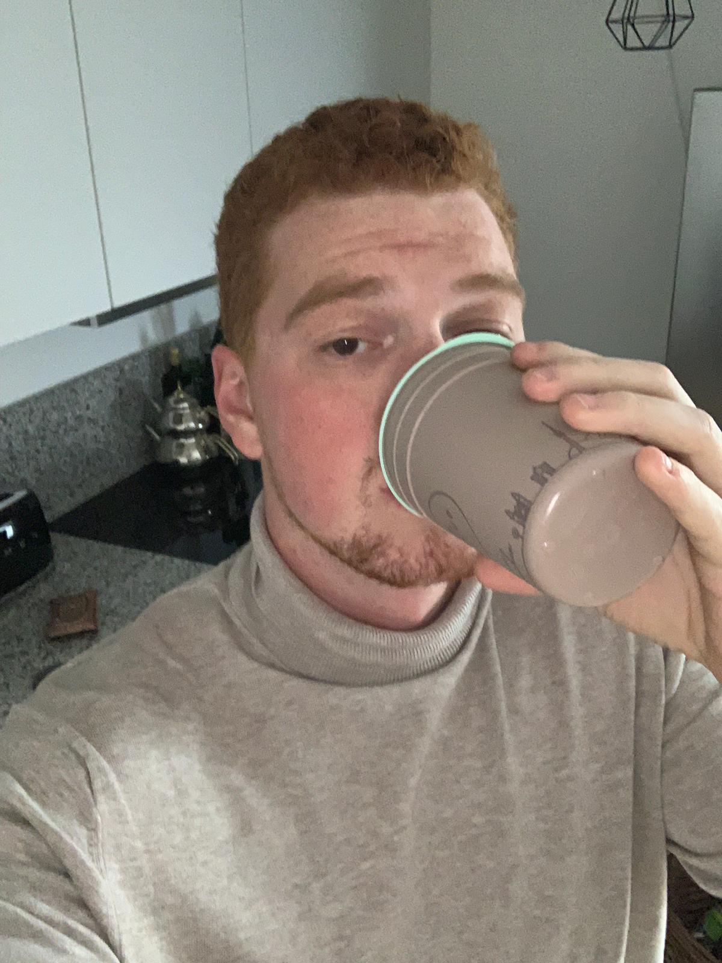

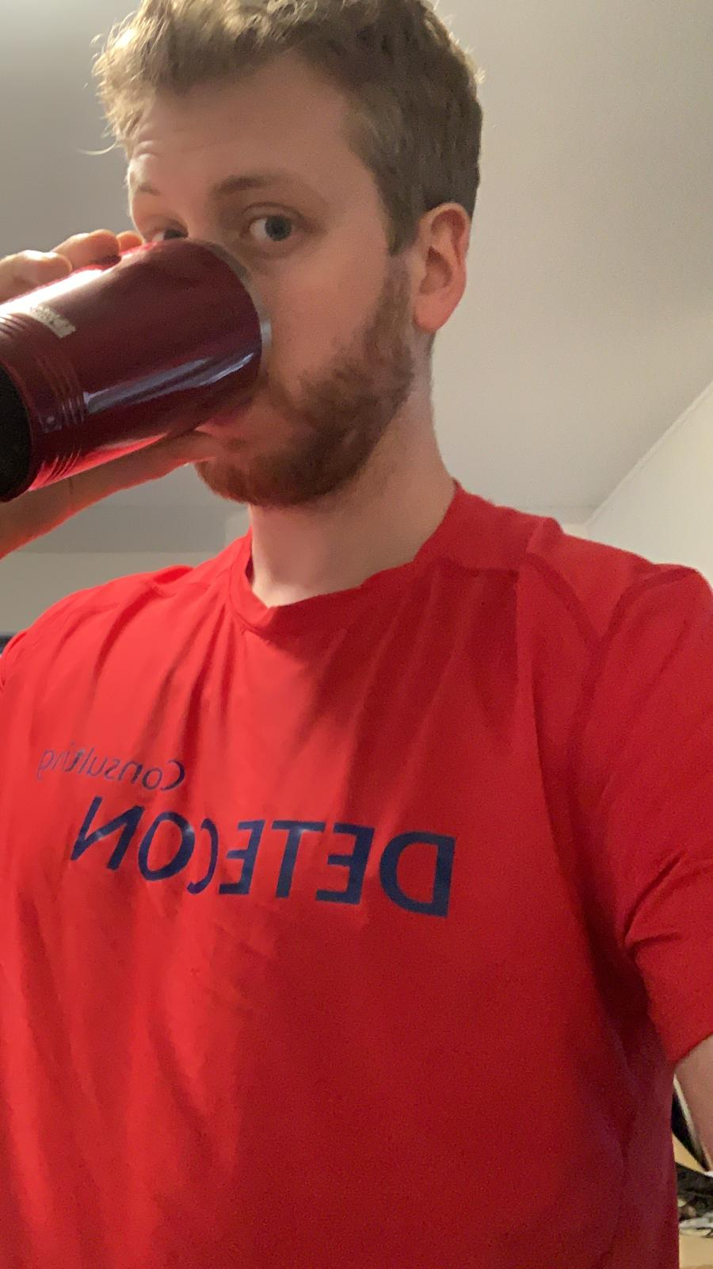


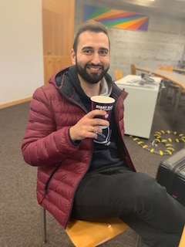
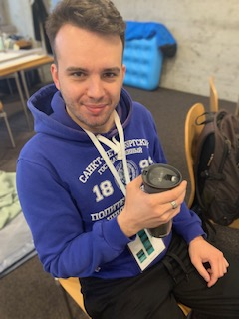
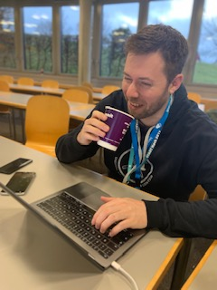
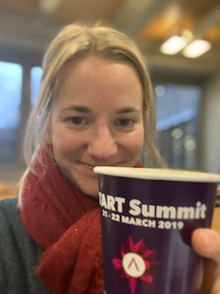
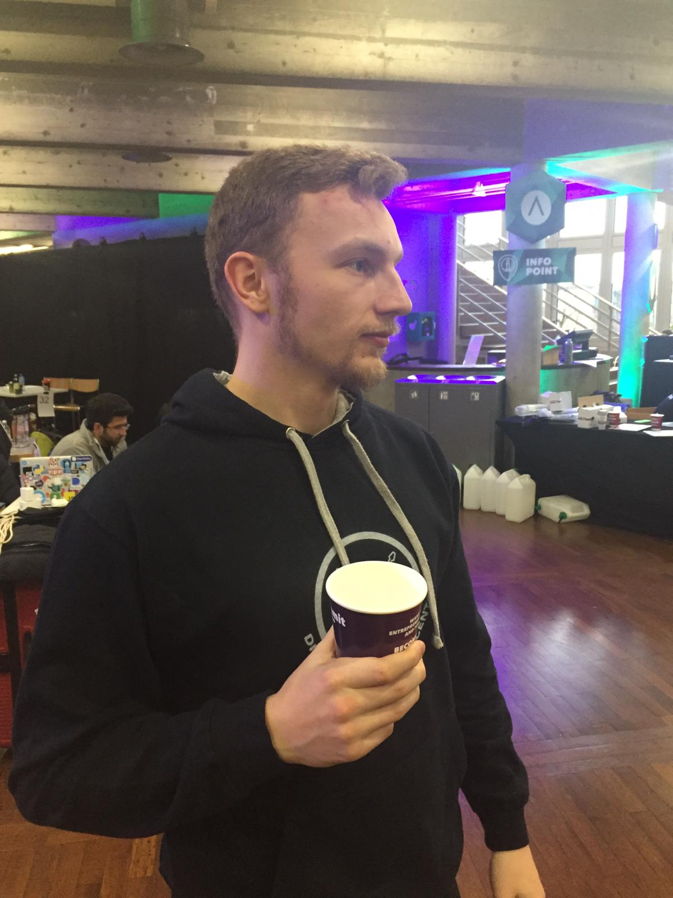
#MONEY = 5 CHF

Slide 9
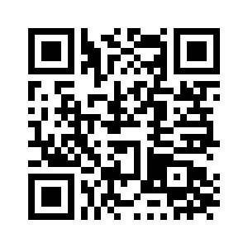
#TRY

Slide 10
#BACK_UP

Slide 11





QR Code
Unique User ID
Payment Details
=
Datahub
QR Code
Unique User ID
Payment Details
RFID
QR Code
Payment Provider
Unique User ID

Slide 12
BUY
DRINK
RETURN
REFLECT
ORDER
“I choose to do good!”
ENJOY
Enjoy coffee as usual. Cup as status symbol.
SEARCH
Find return station. Stress-risk.
RETRIEVE
Get money. See Kanton-ranking. Community sence. Pride. Share on social media.
EMOTIONS
PAY
No extra hassel but higher price than usual.
SCAN
Planning return of cup: where? Scan cup.
RETURN
Game approach for return. Fun. Community.
neutral
Business as usual
Stress risk
Fun and games
#JOURNEY

